Slide 1
Restaurant Management System
Web Application

Slide 2
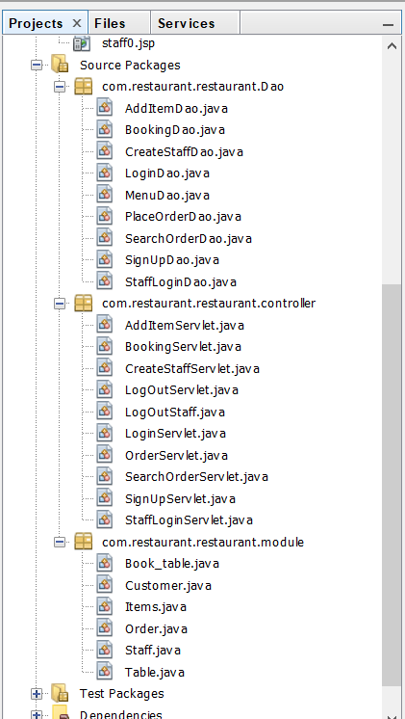
Classes Used
Customer
Book_Table (Extends Table)
Items
Order
Staff
Table
Other Servlets Files
And java files for Database access

Slide 3
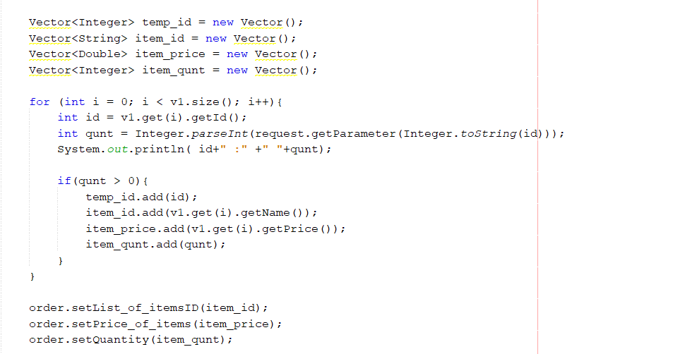
Collections used
Vectors

Slide 4
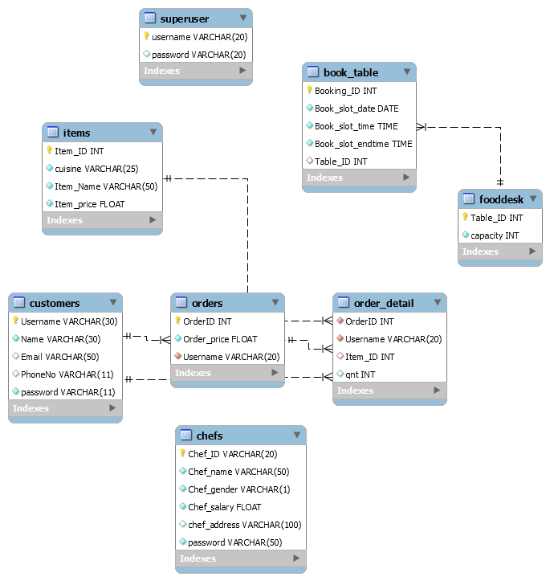
DataBase Schema
Superuser
Customer
Items
Orders
Order _detail
Foodesk (Table)
Chef (Staff)

Slide 5
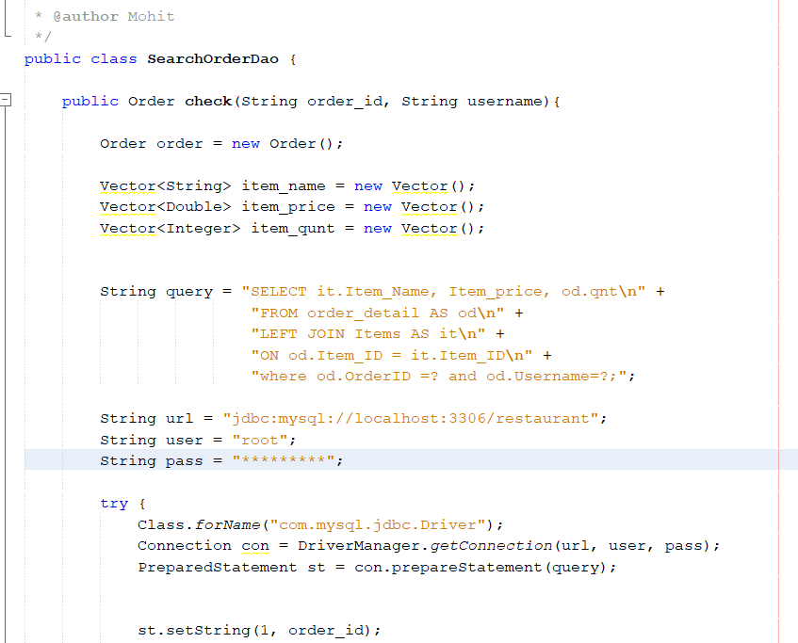
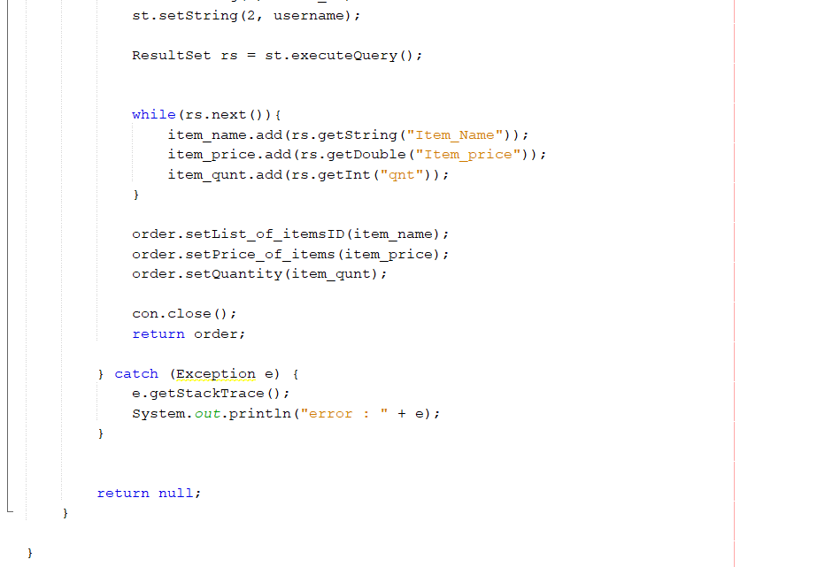
Database Connectivity
Used mysql-connector-java-8.0.16.jar for connectivity
All the java files in Dao package are used for Database Operations

Slide 6
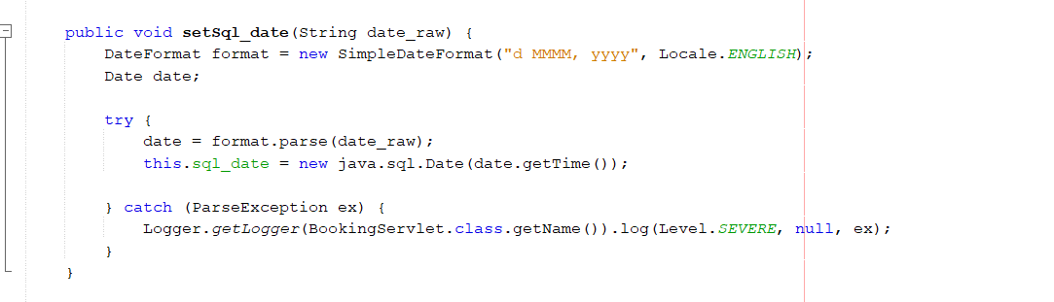
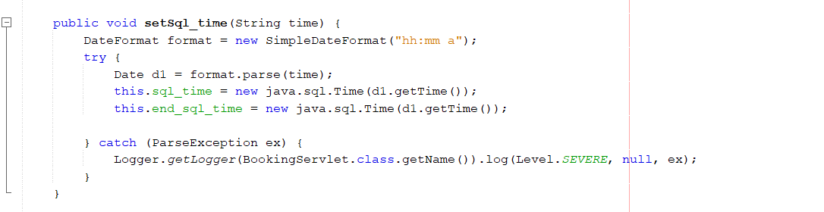
Java and Java.sql datetime

Slide 7
Exceptions
ParseException
ClassNotFoundException
NoSuchMethod
SQLException

Slide 8
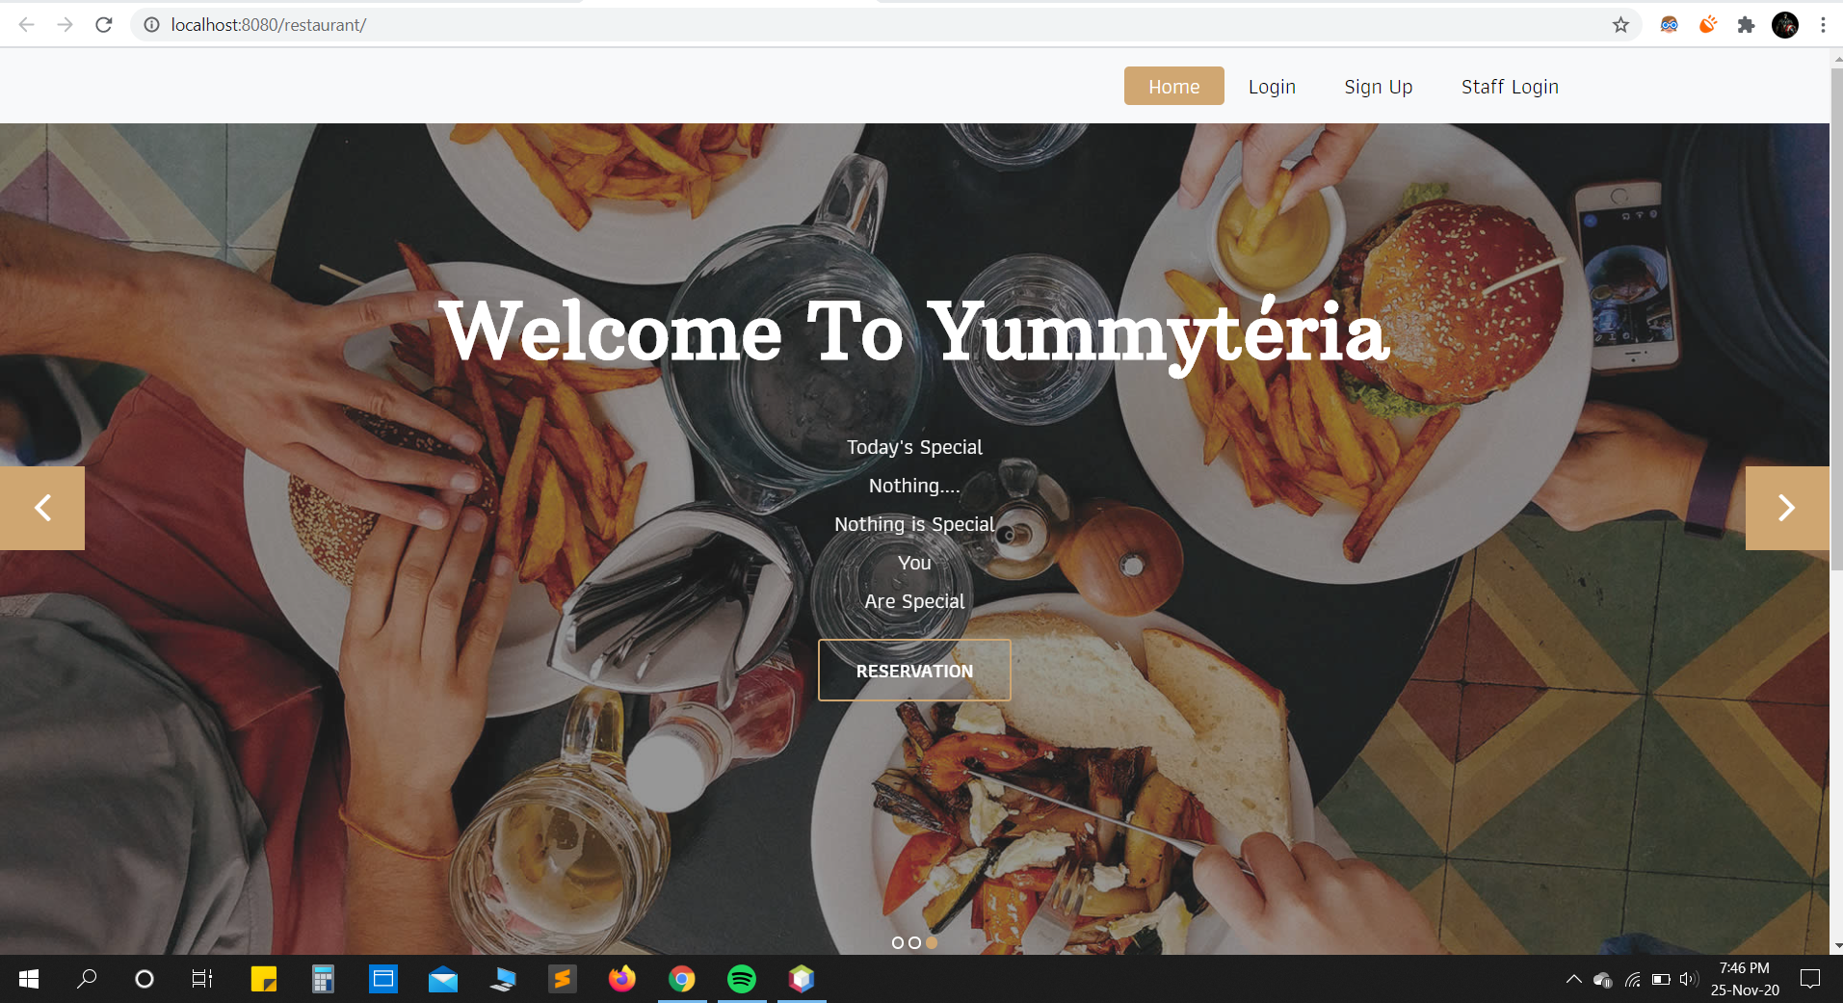
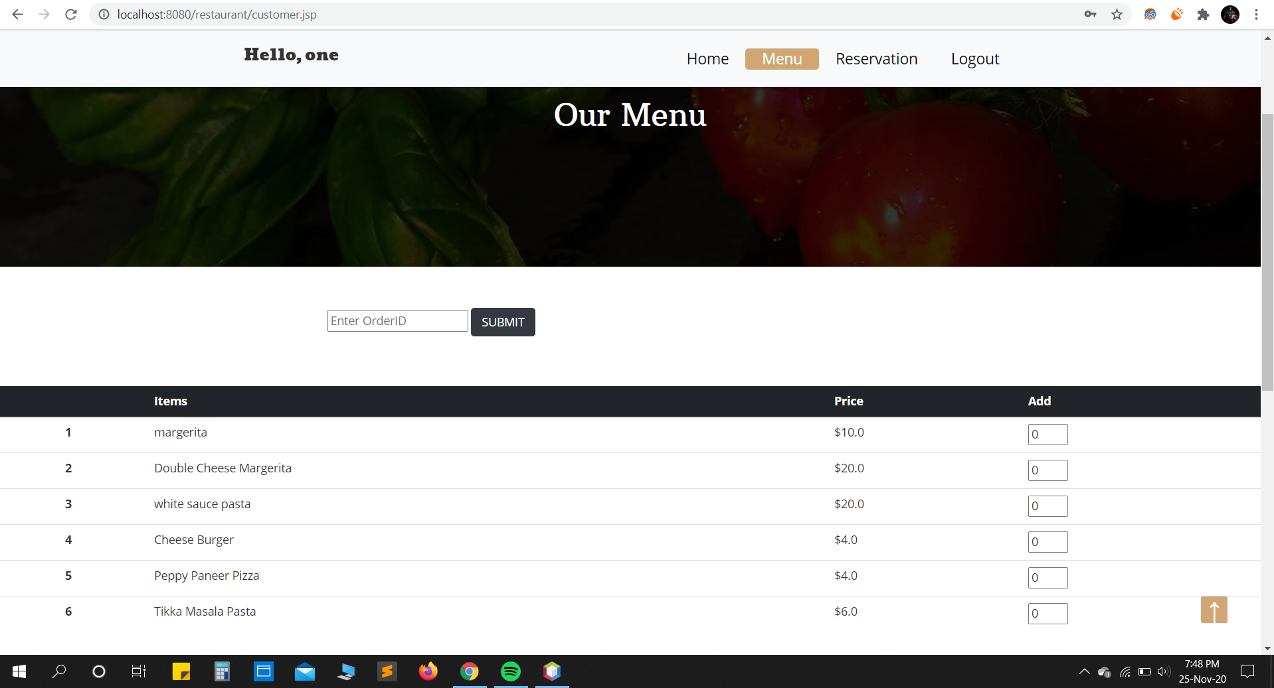
Some Snapshots of Complete Project

Slide 9
